Slide 1
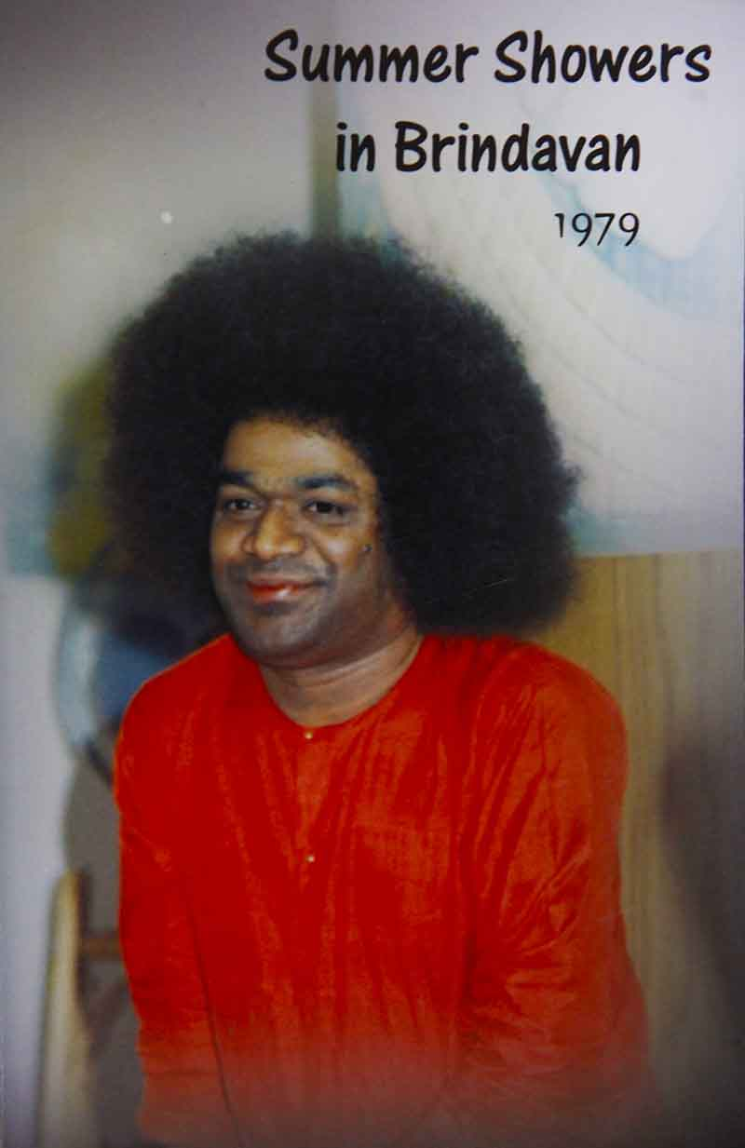
NISHKAMA KARMA
Chapter 2 in SSB 1979

Slide 2
Discourse delivered on the occasion of the inauguration of the All India Sri Sathya Sai Seva Dal District Convenors’ Central Training Camp, to its delegates and to the participants in the Sri Sathya Sai Summer Course in Indian Culture and Spirituality.

Slide 3
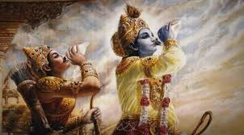
The Bhagavad Gita has proclaimed the path of Nishkama Karma as the royal road to perfection. It exhorts man not to crave for the fruits of action and merely perform one’s duties in a detached manner, leaving the results thereof to the Lord.

Slide 4
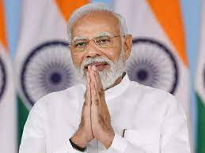
Can one who longs for a position of authority be of pure heart?
It is only when the servant of the nation becomes its leader that he can render selfless service.
Narendra Modi?

Slide 5
In common parlance, it is natural to regard the performance of an action as karma. But, this is not correct. For example, to the question as to what someone is doing, we get the answer that he is writing. Here writing is considered karma. Similarly, when the same question is asked about someone else, we get the reply that he is not doing anything and is merely watching.
Watching is as much an action as writing is. So, too, sleeping and contemplation involve karma. As long as there is life-breath in man, he cannot desist from karma.
In fact, the very process of inhalation and exhalation is karma. There is no need to put in any special effort for work such as this.

Slide 6
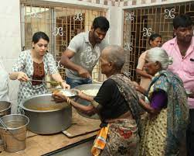
Instead, we should undertake today what is known as Nishkama Karma, or action performed without any desire for the fruit thereof.
Service of the downtrodden, the disabled and the diseased also constitutes an obligation in one’s daily life and cannot be described as being Nishkama Karma or motiveless work. This is because man’s love for the universe is not without selfishness.

Slide 7
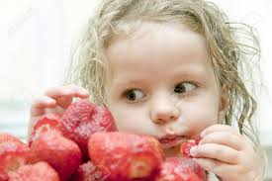
If man loves any object, he does so for his own sake and pleasure. Similarly, if a man conceals an object in a secure place, it is not on account of his love for the object but because of his love for himself. Thus, in the world, all kinds of love are born of love for oneself and not out of love for others.

Slide 8
Nishkama Karma uproots the bestiality in man and confers divinity on him. Selfless service is a more exalted means of spiritual progress than such other ways as meditation, bhajan and yoga. This is so because when we undertake meditation, japa, or yoga, we do so for our own benefit and not for the good of others. These are aimed at subjugating one’s individual desires and securing happiness for oneself. What we should aspire for is the attainment of the good of others without any desire for personal gain.
SELFLESS SERVICE > MEDITATION, BHAJAN, YOGA

Slide 9
Man should regard Nishkama Karma as the purpose for which he is given life.

Slide 10
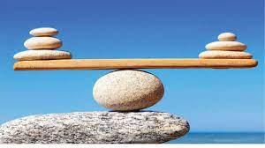
The word “duty” would have no meaning at all if there were only one individual. It assumes significance only if there is a society or a community, or at least two persons. Here we should understand two aspects closely related to “duty.” These may be termed “individual freedom” and “fundamental right.” “Individual freedom” refers to the freedom an individual has, whereas “fundamental right” brings into focus his relation to society. Man must endeavour to ensure that there is proper balance between the two.
INDIVIDUAL FREEDOM
FUNDAMENTAL RIGHT

Slide 11
We should seek only that kind of liberty which does not obstruct the freedom of others. Should you hamper the independence of another individual in the course of an egotistic display of your individual freedom, you are sure to be condemned by society. The man next to you enjoys the same amount of licence that your own individual freedom affords you.

Slide 12
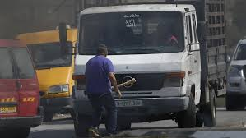
There is a small example to illustrate this: trying to make the most of your own individual freedom, you may gaily stroll down the road, wielding a large stick in your hand. Yet, a man coming from the opposite direction has just as much freedom to dodge the stick as you have to wield it. If you behave in a manner which impairs the freedom of another, you stand to receive societal disapproval or governmental censure. Thus, what we understand by the word “duty” is that the privileges and the rights enjoyed by us on account of our individual freedom, are also claimed by others who are around us.

Slide 13
It is puerile to say that God would do everything by Himself simply because He is omnipotent. Here is an illustration. There are two individuals who are devotees of the Lord. One of them prays to God for rain to prevent his crops from getting dried up. The other, however, prays to Him for the absence of rainfall for a few days in view of a grand marriage ceremony he had intended to perform in his house shortly. Thus, they put the Lord in a dilemma. Which devotee’s prayer should God answer?

Slide 14
Here, we should ask ourselves the question as to whether God has received these prayers Himself directly or not. Even as there is a delegation of authority in the administration of a terrestrial kingdom by a ruler, by which various governmental functions are performed by several ministers who are assigned the charge of certain departments and portfolios, in running the affairs of the Cosmos, the Almighty God, too, assigns certain functions to certain gods like Indra, Varuna, and Rudra.

Slide 15
Just as all earthly matters are not taken directly to a king, but are presented to the concerned ministers for action, all prayers of man do not reach God Himself— they are attended to by His “ministers”, Indra, Varuna and others.
Only those prayers which have their origins in the spirit of Nishkama Karma, infinite and pure love and an unsullied heart, reach the Lord directly. It is not possible for prayers of any other kind to reach Him directly.

Slide 16
You may be thinking in this context that you are living as brothers in keeping with the laudable ideal of “Brotherhood of man and Fatherhood of God.” There is, however, a higher ideal that is to be sought after, for it is not uncommon to observe brothers quarrelling with one another and totally severing their connections.

Slide 17
“Ekam sat viprah bahudha vadanthi”—the one truth is spoken of in different ways by the wise. “Ekoham bahusyam,” I am One; let Me be many. “Ekam eva advitiyam Brahma,” Brahman is only One, without a second. “Easwara sarva bhootanam”—God is in all beings. “Isavasyam idam sarvam”—The entire world is enveloped by the Lord. This is the inner meaning of these Upanishadic declarations—behind the apparent physical differences, the one basic Truth, the Atma, resides in all beings. We should, therefore, live our lives with a constant awareness of this profound verity.

Slide 18
Here is an illustration to explain that the good deeds do bring back good to oneself. Three cups of coffee were prepared in a home. The husband drank one cup and the wife, another. While they were debating as to whether they should share the third cup or let one of them have it, a friend called at the house and was cordially offered the coffee. The husband felt pleased that he had not only averted a quarrel with his wife but also performed the service of offering coffee to his friend. Three months later, the husband visited his friend’s house. The friend extended due hospitality and offered him a cup of coffee, reciprocating the favour he had received earlier. Had he not been given the cup of coffee three months earlier, he would not have returned the hospitality. So, we see that the householder got back his cup of coffee after three months. In the same manner, we are repaid for our deeds in some way or the other, whether we know it or not, and in the same coin.

Slide 19
If, without performing good deeds, you pray for personal gain, God merely listens to your entreaties, but does not favour you with His benediction. A story from the Mahabharatha portrays this succinctly. On an occasion, during the celebrations associated with the Sankranthi festival, Krishna was partaking of the freshly harvested sugarcane offered to Him by the gopis in accordance with the custom. As there were no machines those days, to squeeze the juice out of the sugarcane, Krishna had to cut it. While doing so, He inadvertently cut his little finger. Seeing blood on His finger, Sathyabhama, in her characteristic ego, ordered the gopis to go inside the house and fetch some cloth to bandage the finger. Draupadi who was also there, however, out of her love and concern for Krishna, immediately tore off a piece of cloth from the end of her sari and bandaged the Lord’s finger.

Slide 20
Years later, when Dussasana brought Droupadi to the court of the Kauravas with the intention of humiliating her in public, she appealed to Krishna for His Divine intervention to save her honour. Krishna pondered over it for a few moments to see whether she deserved to be rescued from her present predicament by virtue of any related good deed done by her in the past, which could be recompensed. After a little deliberation, Krishna remembered that the tying of a bandage, improvised by her, at one time in the past, entitled her to receive a similar gift. Therefore, He sent her an endless sari with the same little finger that had needed a bandage then.

Slide 21
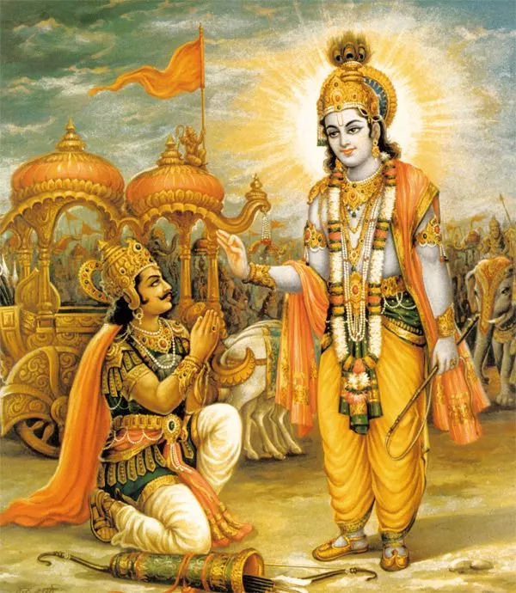
Karmanyeva adhikaraste—we must concern ourselves only with the action to be performed by us; the Lord will bestow on us the fruits thereof when the need arises.

